Slide 1

1000 BRITISH AIRWAYS REVIEWS COLLECTED ON AUGUST 19, 2023
Dwi Putra Satria Utama

Slide 3
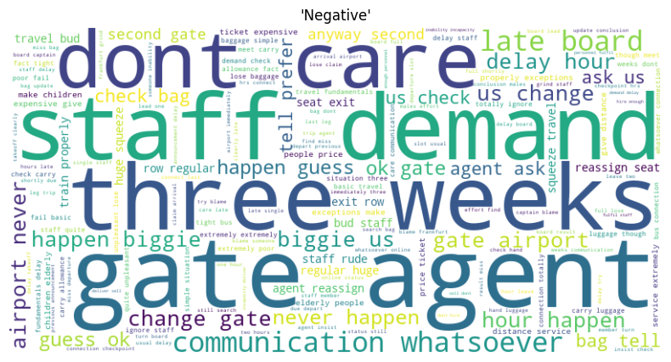

Slide 4
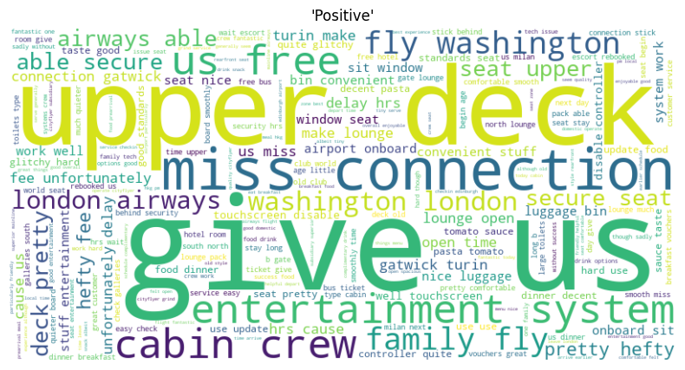

Slide 5
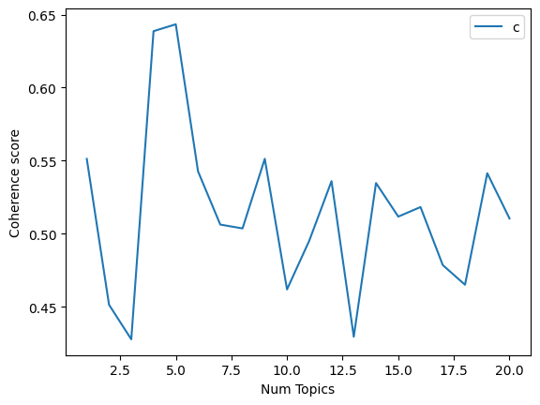

Slide 6
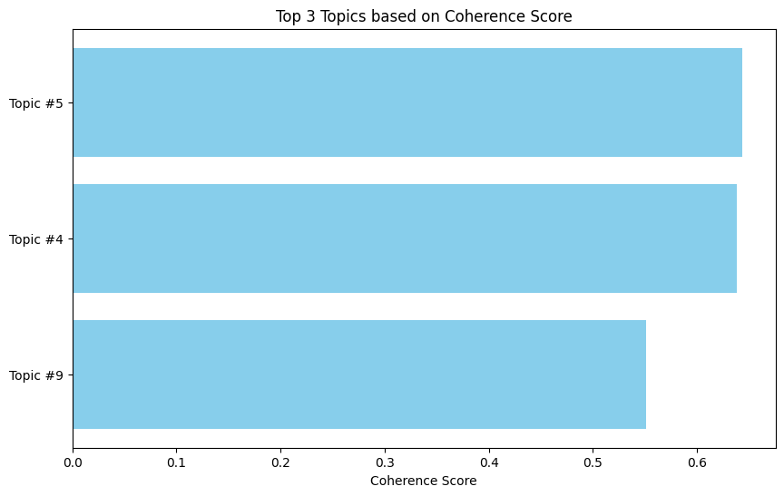
Customer Service and Experience
Keywords: extremely, carry, children, price, distance, elderly, rude, train, poor, expensive.
This title may be suitable for keywords that encompass customer experience, service, ticket pricing, and interactions with staff.
Flight Delays and Issues
Keywords: late, board, cityflyer, dont, blame, hire, incapacity, demand, inability, deliver.
This title could reflect keywords related to flight delays, airport issues, and the inability to provide timely service.
Communication and Service Quality
Keywords: late, board, dont, cityflyer, blame, communication, three, lose, care.
This title can reflect communication issues, service quality, and dissatisfaction related to the airline's service.

